Slide 1
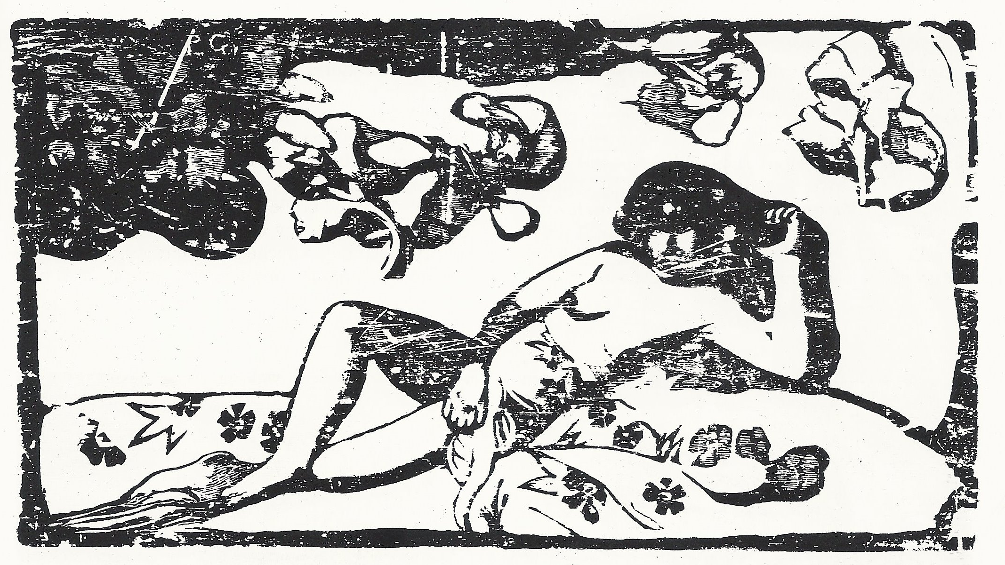
Classical
PRINTING METHODS

Slide 2
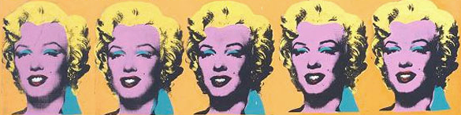
PRINTING
Graphic – meaned „Classical printing methods“ is one of the visual arts like painting and drawing.
Painting is usually based on colours and drawing is based on lines.
Printing uses both - colours and lines. The difference is, that the printing technique allows you to make copies of your image. Each print is an original.

Slide 3
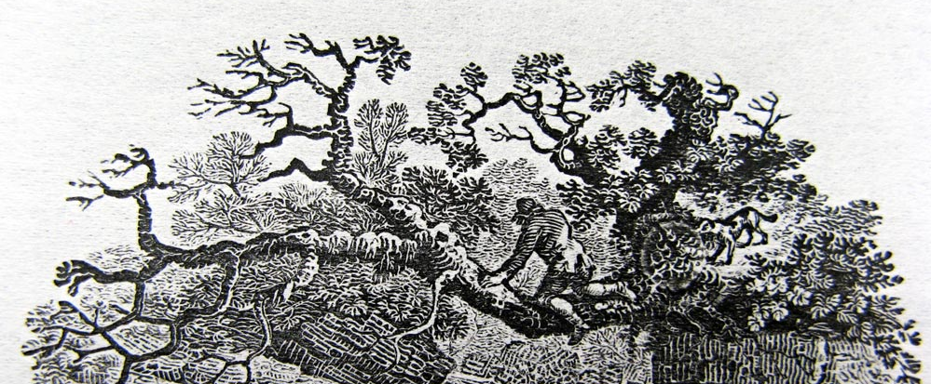
PRINTING AREAS
All printing process is divided into two kinds of areas of the final output:
1) Image area (printing areas)
2) Non-image area (non-printing areas)

Slide 4
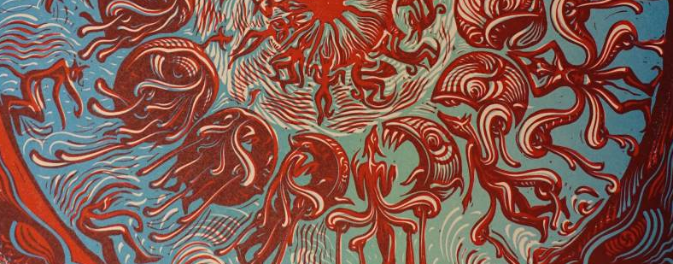
COLOUR PRINT
The colourful print is usually more difficult than painting because every colour is mostly printed separately. Here we can see the light red colour, the dark red colour and the blue.

Slide 5
PRINTING METHODS
There are four kinds of classical printing methods groups. The several techniques in each of them, have similar ways how to make a print. It is: oprav
Relief printing
Intaglio printing
Planographic printing
Porous printing

Slide 6
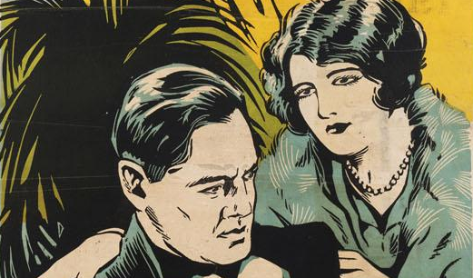
Relief printing
The printing areas are on a plane surface and the non-printing areas are below the surface. It works basically like a rubber stamp.
The examples:
Linocut/linoleum-cut
Woodcut
Wood engraving
Paper print
Pressure print

Slide 7
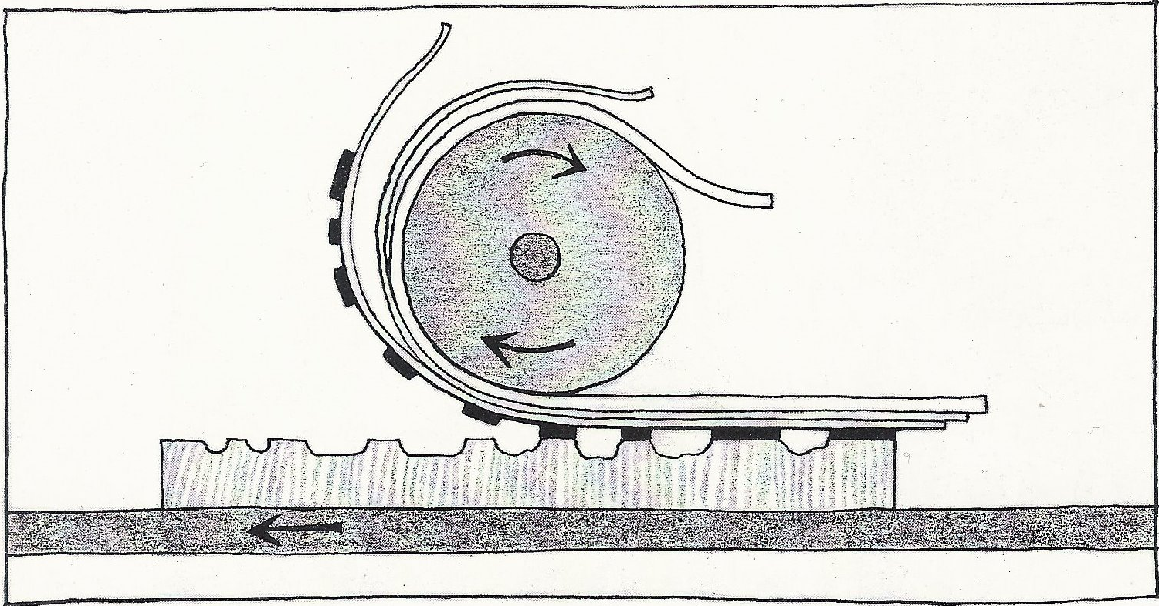
Connect:
Imprint
Felt
Pressure
Ink
Cylinder
Wood/linoleum
printing plate
Sheet

Slide 8
Intaglio printing
The non-printing areas are on a plane surface and the printing area are etched or engraved below the surface.
The examples:
Gravures:
Drypoint
Copper engraving
Steel engraving/ steel die engraving
Mezzotint
Etchings:
Etching
Soft-gound etching
Aquatint

Slide 9
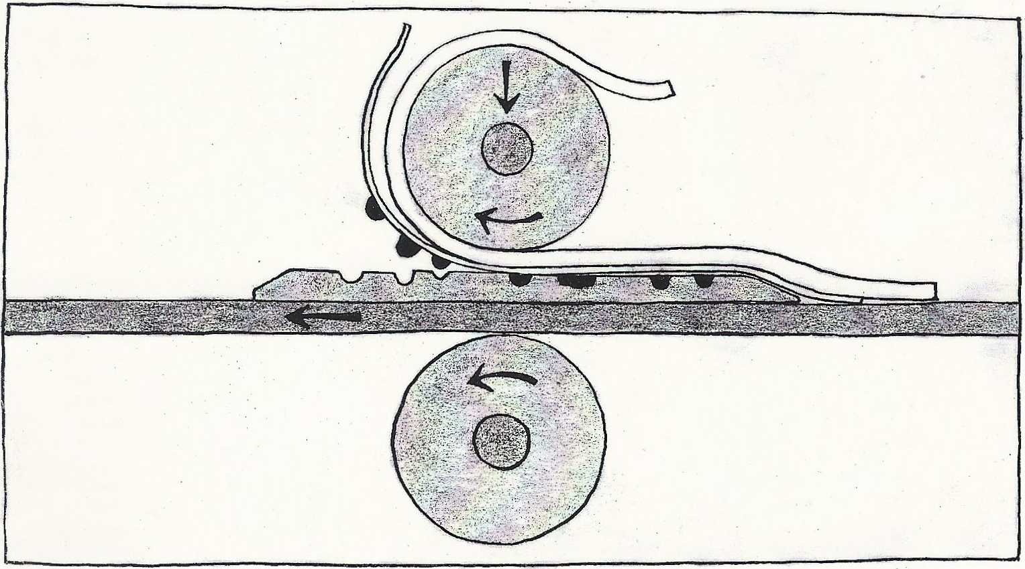
Connect:
Imprint
Felt
Pressure
Ink
Cylinder
Metal matrix
Sheet
Pad (fazeta)

Slide 10
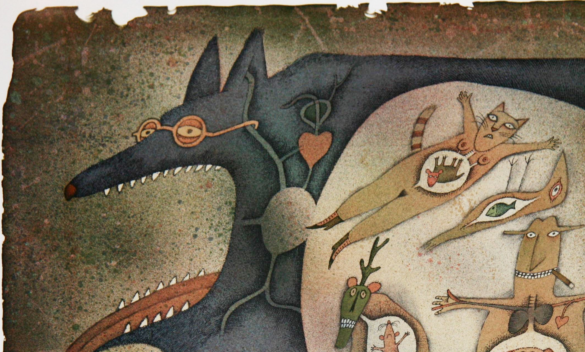
Planographic printing
The printing and non-printing areas are on the same plane surface and the difference between them is maintained chemically or by physical properties.
The examples are:
Litography
Algraphy
Offset lithography printing
Monotype

Slide 11
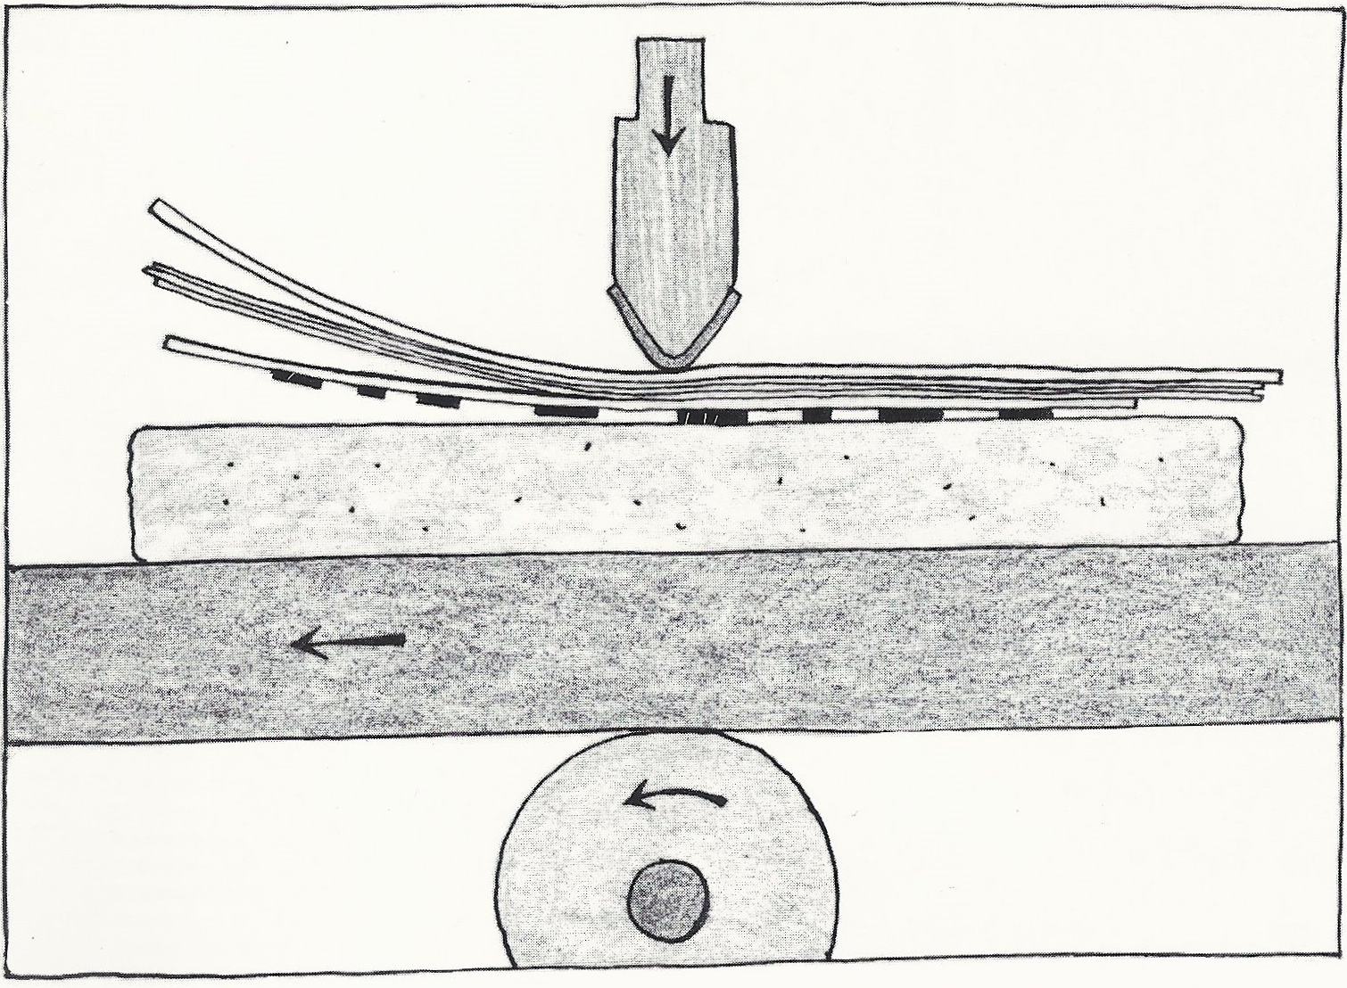
Connect:
Imprint
Pressure
Ink
Cylinder
Stone or metal matrix
Sheet
Squeegee

Slide 12
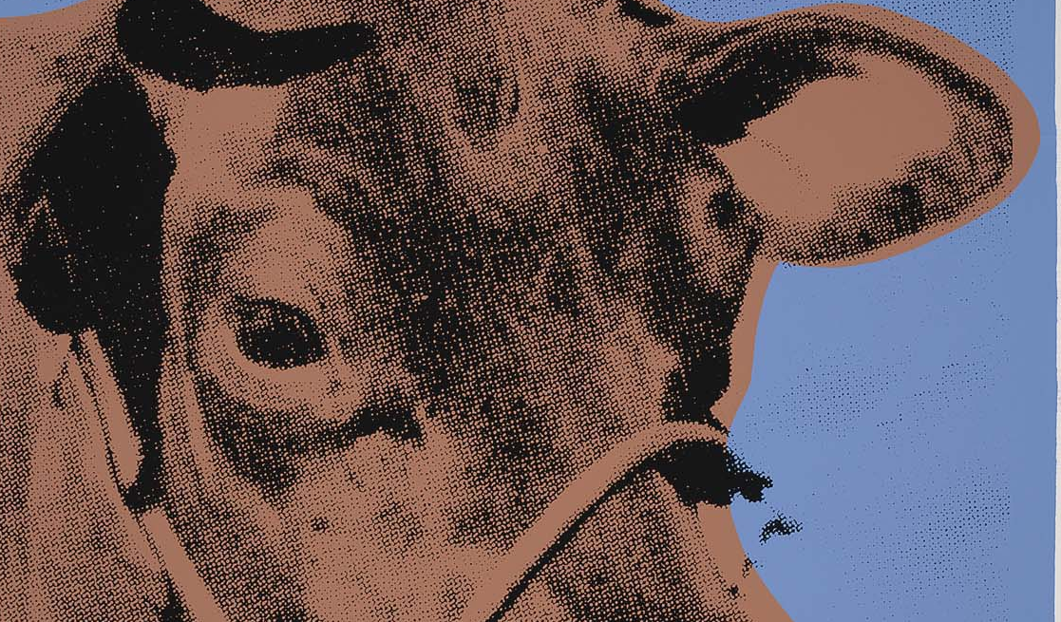
Porous printing
The printing areas are on fine mesh screens through which ink can penetrate, and the non-printing areas are a stencil over the screen to block the flow of ink in those areas.
examples:
Serigraph/screen printing
Stencil duplicator

Slide 13
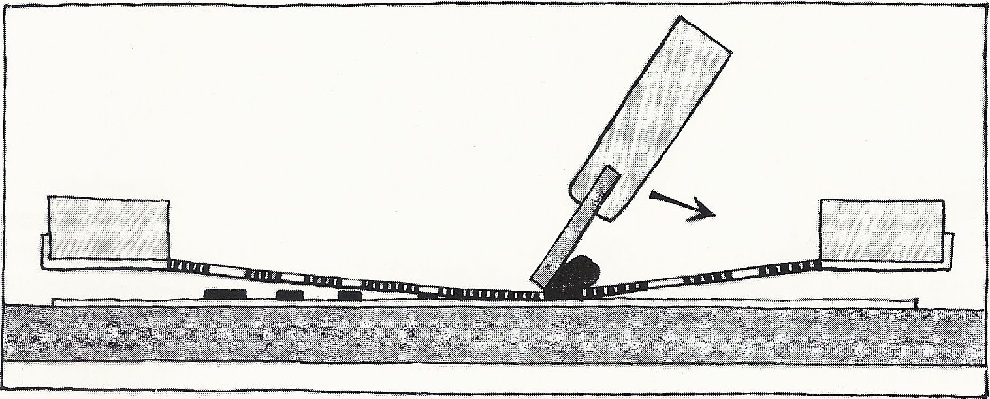
Connect:
Imprint
Pressure
Ink
Metal ow wooden frame
Screen
Sheet
Squeegee

Slide 14
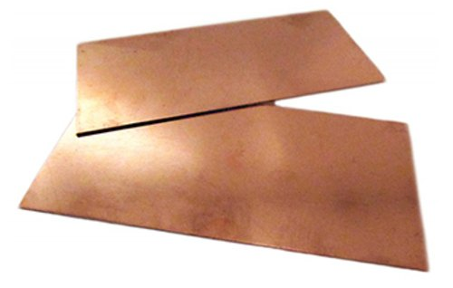
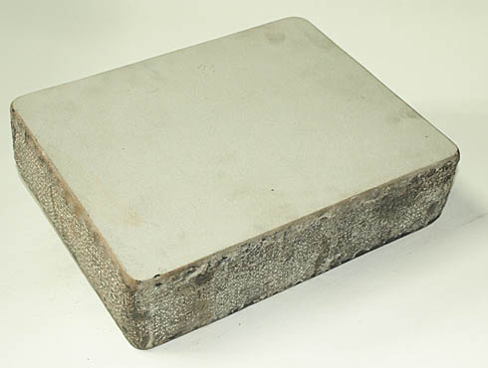
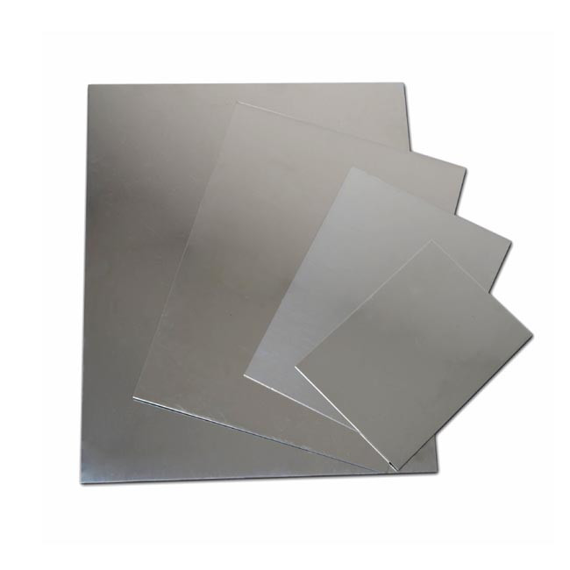
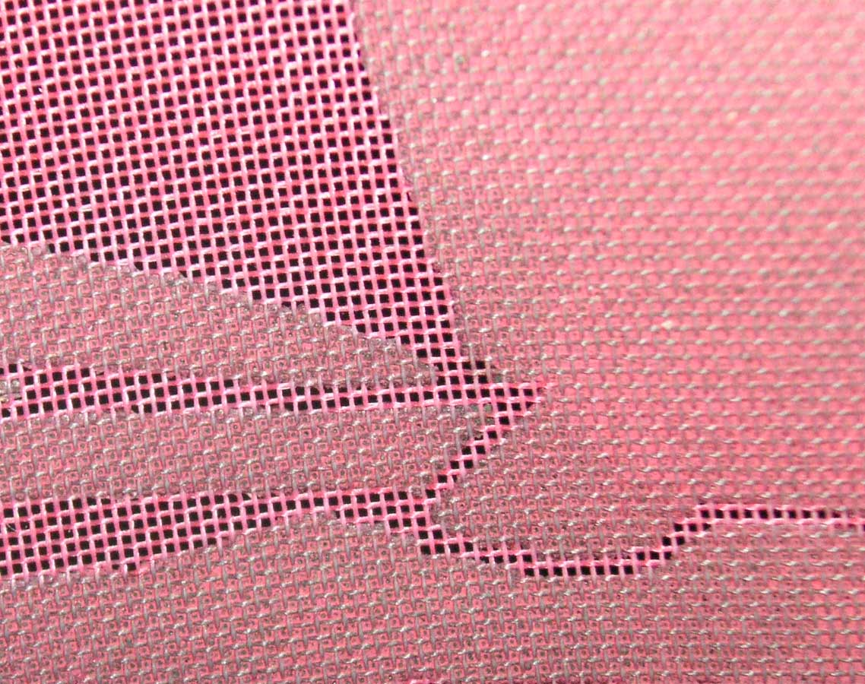
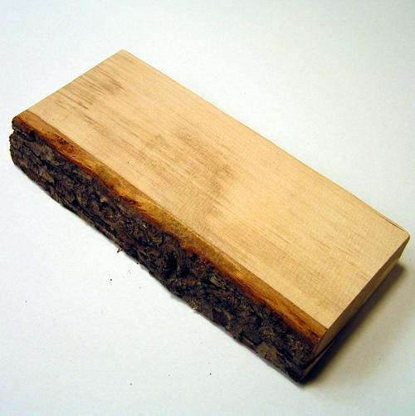
What material can be printing plate from?

Slide 15
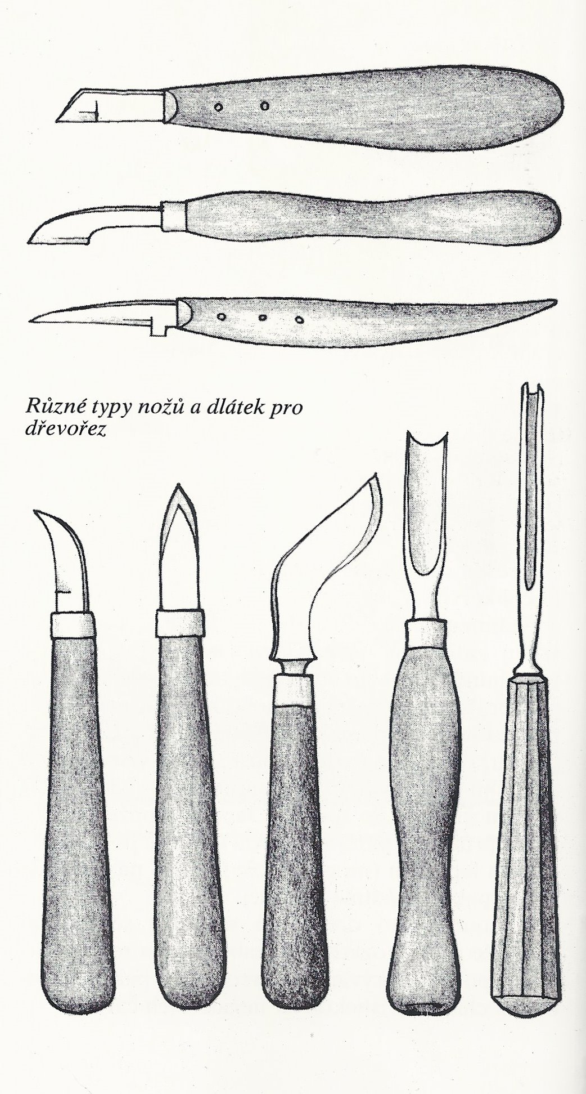
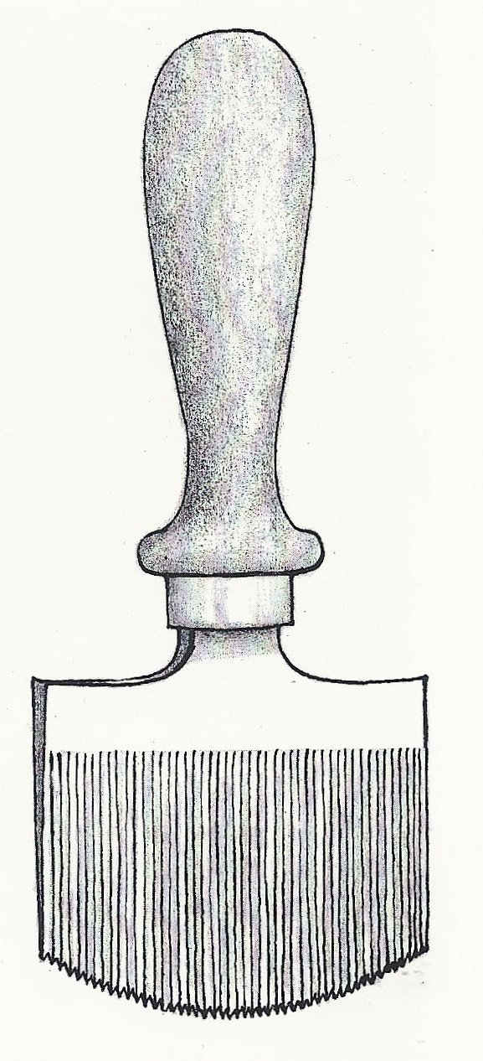
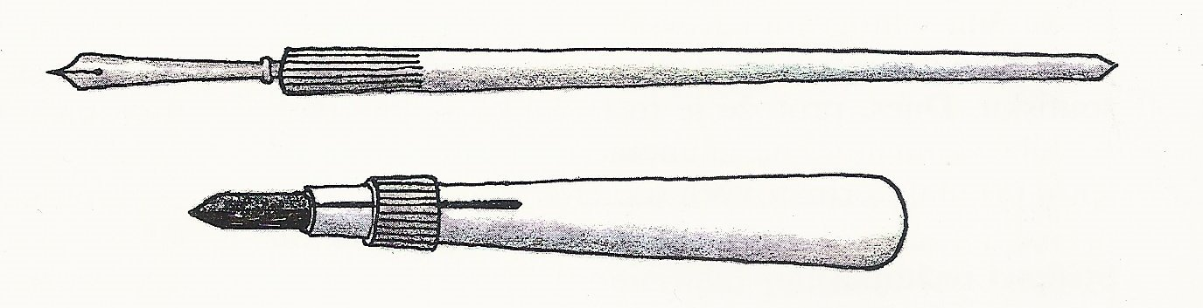
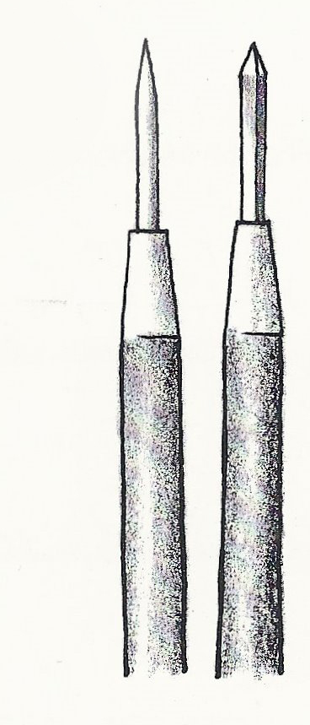
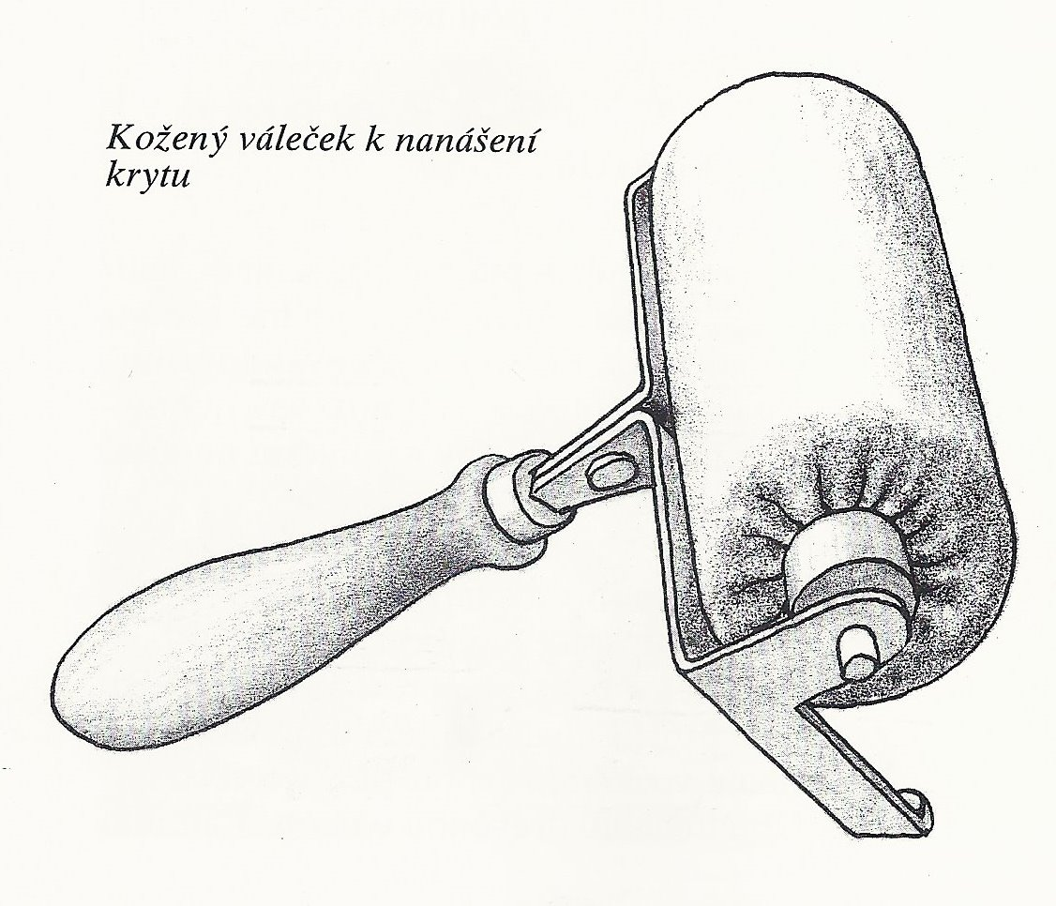
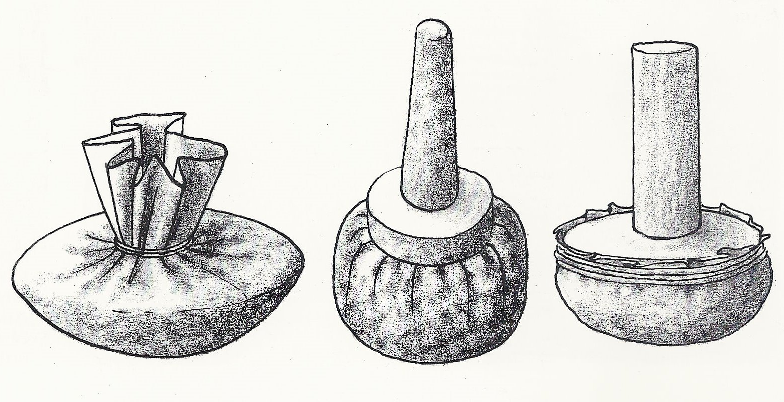
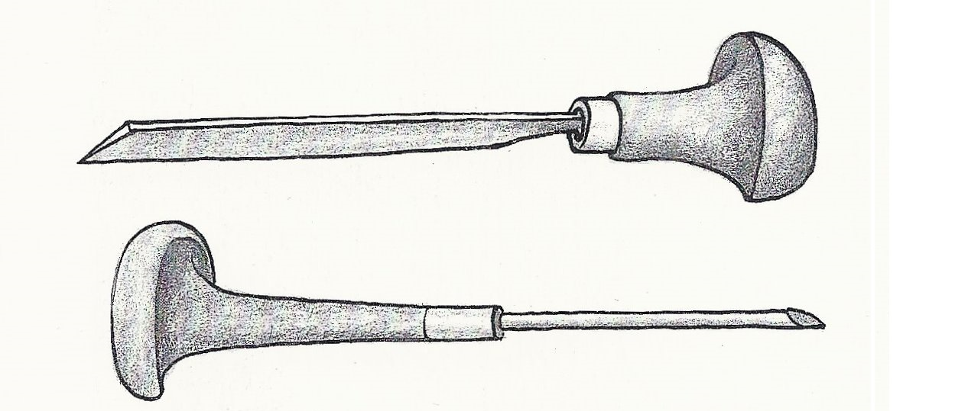
What tools do you need?
Connect the pictures with the name of the tool and guess, in which technique you need it?
bayer, cutter, curving tool, chalk, pen, rocker, leather pad, stylus, chisel

