Slide 1
Málaga
Josef Janko

Slide 2
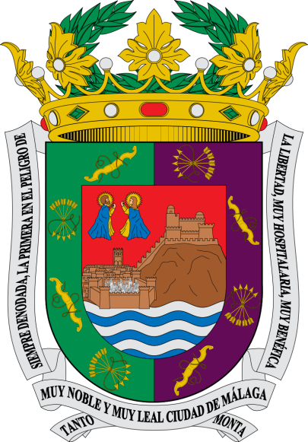

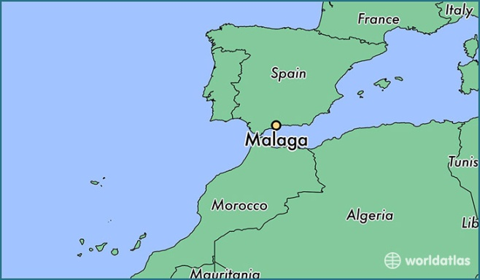
Málaga
Málaga is the port city in the south of Spain. Is the province of Málaga. After Seville is the second largest city in Andalusia. With a population of 576 725 is 6. the largest city in Spain.
In the city is located the international airport, the port and the university. Thanks to the pleasant climate is Malaga one of the most popular tourist destinations of the Iberian peninsula.
There was born the popular painter Pablo Picasso

Slide 3
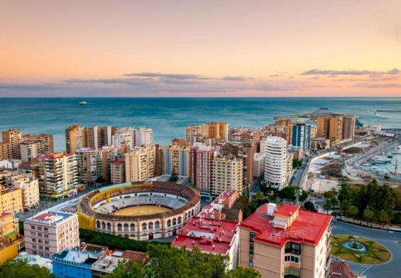
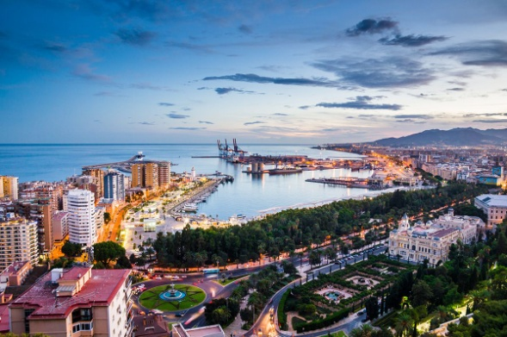
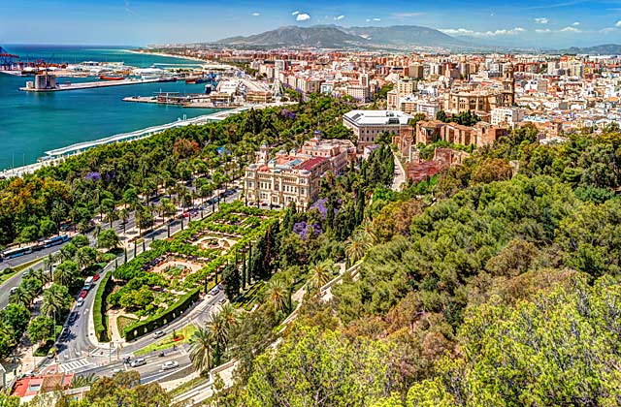
Geography and climate
Málaga, which lies on the west coast of the Mediterranean sea on the Costa del Sol, surrounded by the mountains of the Sierra de Mijas and Montes de Málaga.Through the cite flow the river Guadalmedina and the Guadalhorce, which flow into the Mediterranean sea.
In Málaga is a mediterranean climate, the weather is for most of the year sunny. Summer is exceptionally dry and hot, temperatures are very often well over 30 °C. The winters are mild.

Slide 4
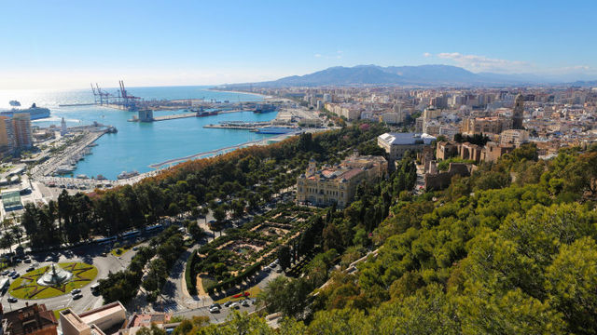
Parts of the city
The city is divided into 10 major districts (= distritos).
Centro
Este
Ciudad Jardín
Bailén/Miraflores
Palma/Palmilla
Cruz de Humilladero
Carretera de Cadiz
Churriana
Campanillas and Puerto de la Torre
which are again divided into hundreds of smaller Barrios (residential or industrial area).

Slide 5
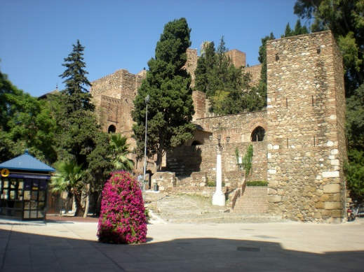
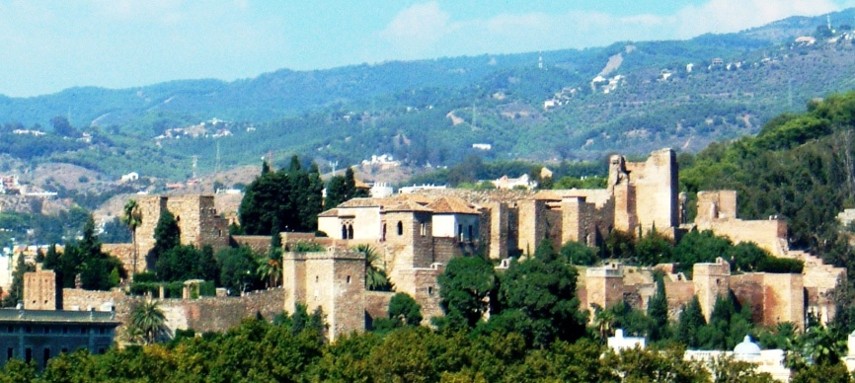
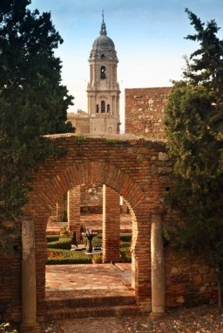
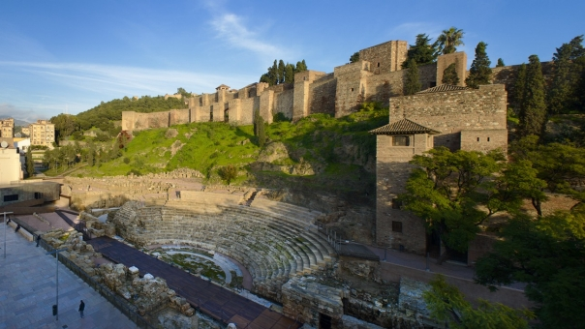
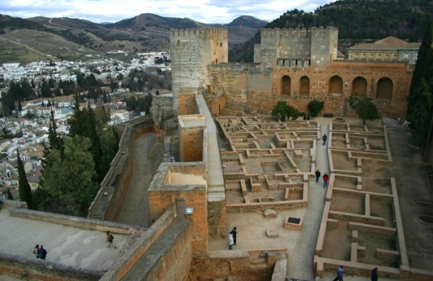
Sights and hiking
Alcazaba
The Alcazaba is a moorish fortress from the 11th. century, which was built on the ruins of a phoenician palace. It was built for the moorish king of Granada, and in 14. century expanded. There are even ancient ruins of the roman amphitheater.

Slide 6
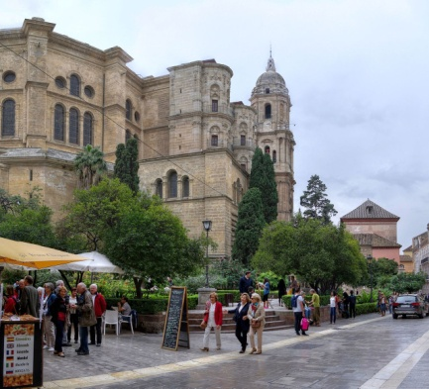
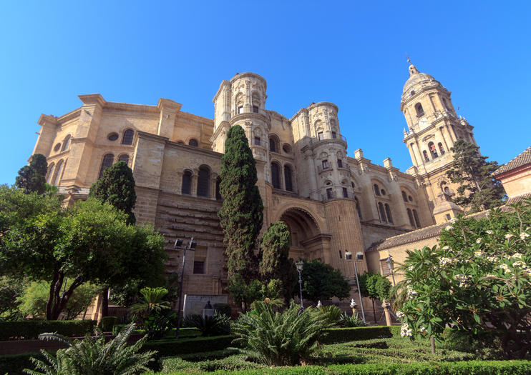
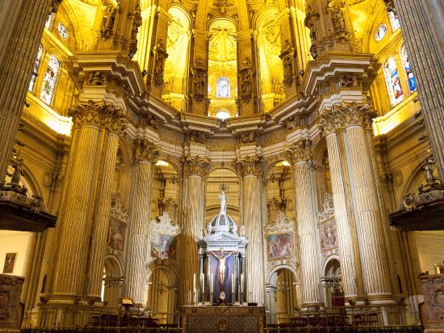
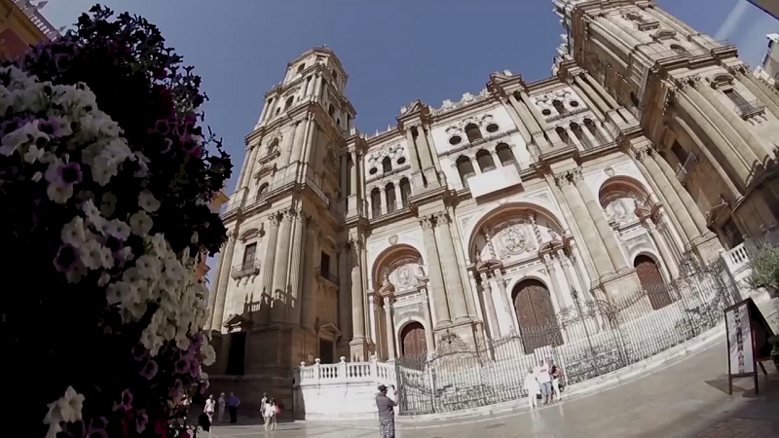
Sights and hiking
The Cathedral
The cathedral Catedral de la Encarnación, was built by the christian conquerors of 1528, instead of the great mosque. It is also called the La Parking, because its second tower was not due to lack of money will never be completed.

Slide 7
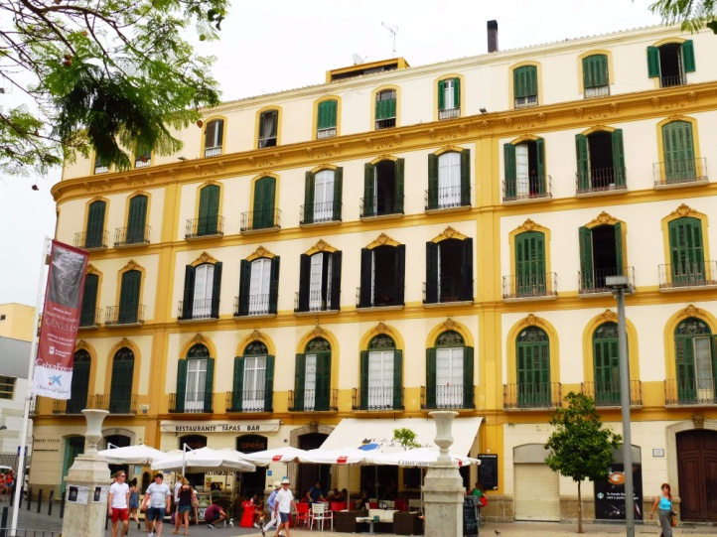
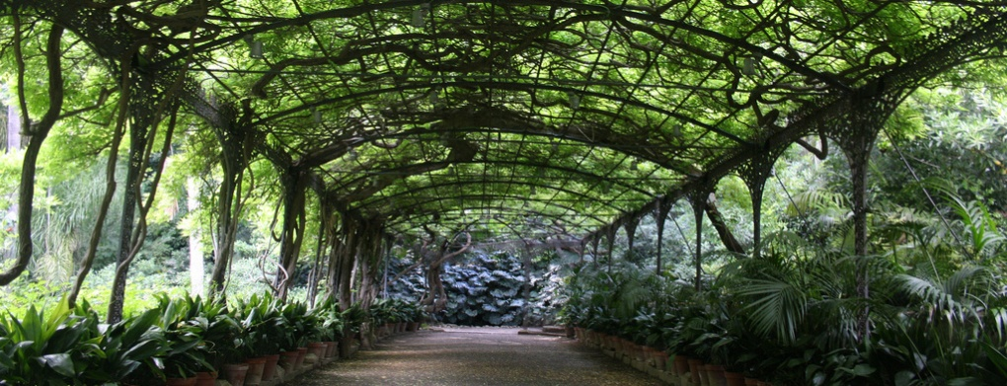
Other tourist destinations
the native house of Pablo Picasso in Plaza de la Merced.
the botanical garden "Jardín Botánico-Histórico La Concepción", a park with 3000 local plants and palm trees,
the"Santuario de la Victoria"Paseo del Parque"
"Parque de Málaga" park designed as a botanical promenade with a total area of about 30.000m2
And otrhers

Slide 8
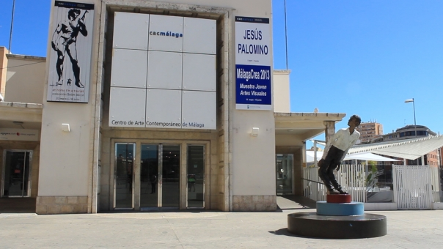
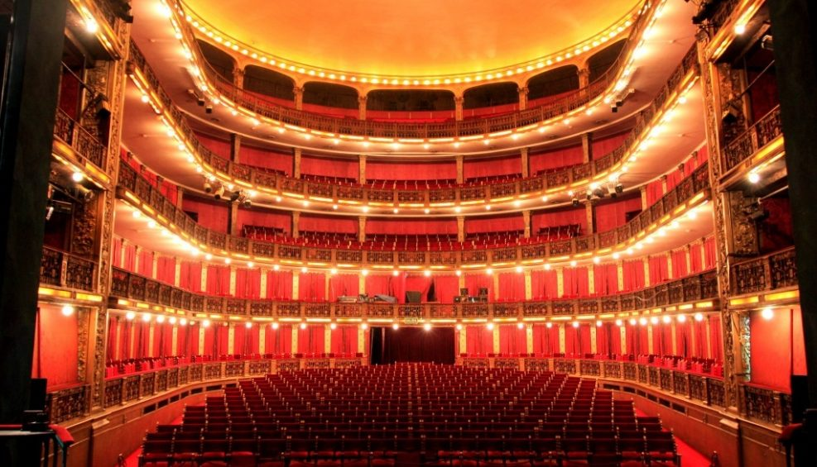
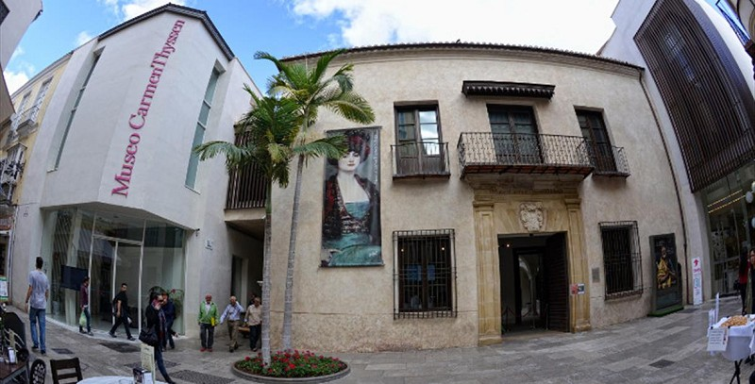
Culture
Museum
Centro de Arte Contemporáneo Málaga
Museo Picasso
Museo Carmen Thyssen
Theatre
Teatro Cervantes

