Slide 1
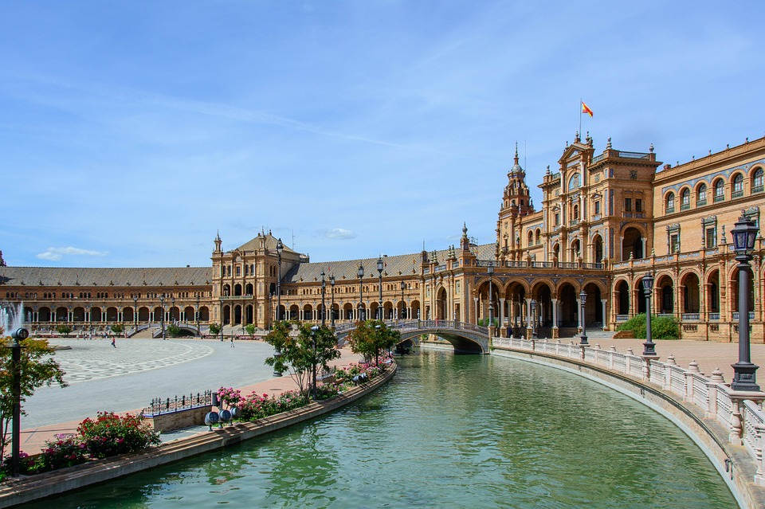
History of Spain and Sevilla

Slide 2
Spain
Humans were already living in Iberian Peninsula as early as 1,2 millions years ago
Romans came on Spain around 300 B.C.
In 7th century Spain became Muslim
In 15th century Spain started period of Catholic Monarchy
https://www.youtube.com/watch?v=nPcfZLaMoAo

Slide 3
Sevilla
Originally an Iberian town
Ancient Hispalis after Romans coming
After the discovery of America Sevilla was one harbour in Spain which sailed ships to New world

Slide 4
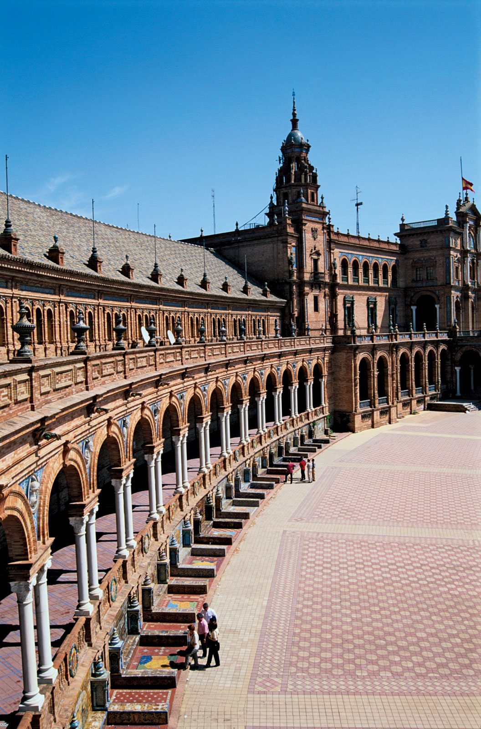
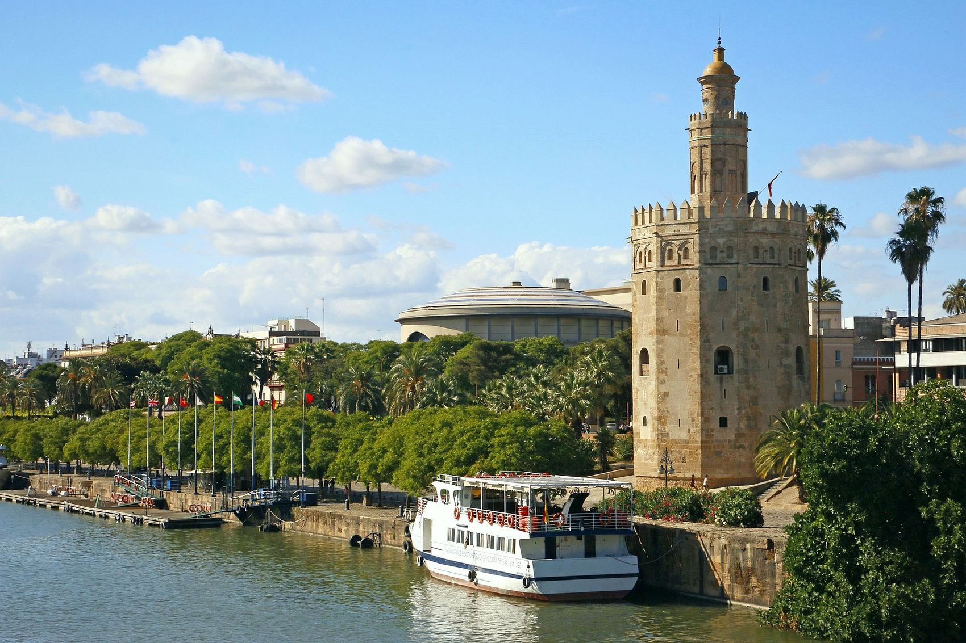
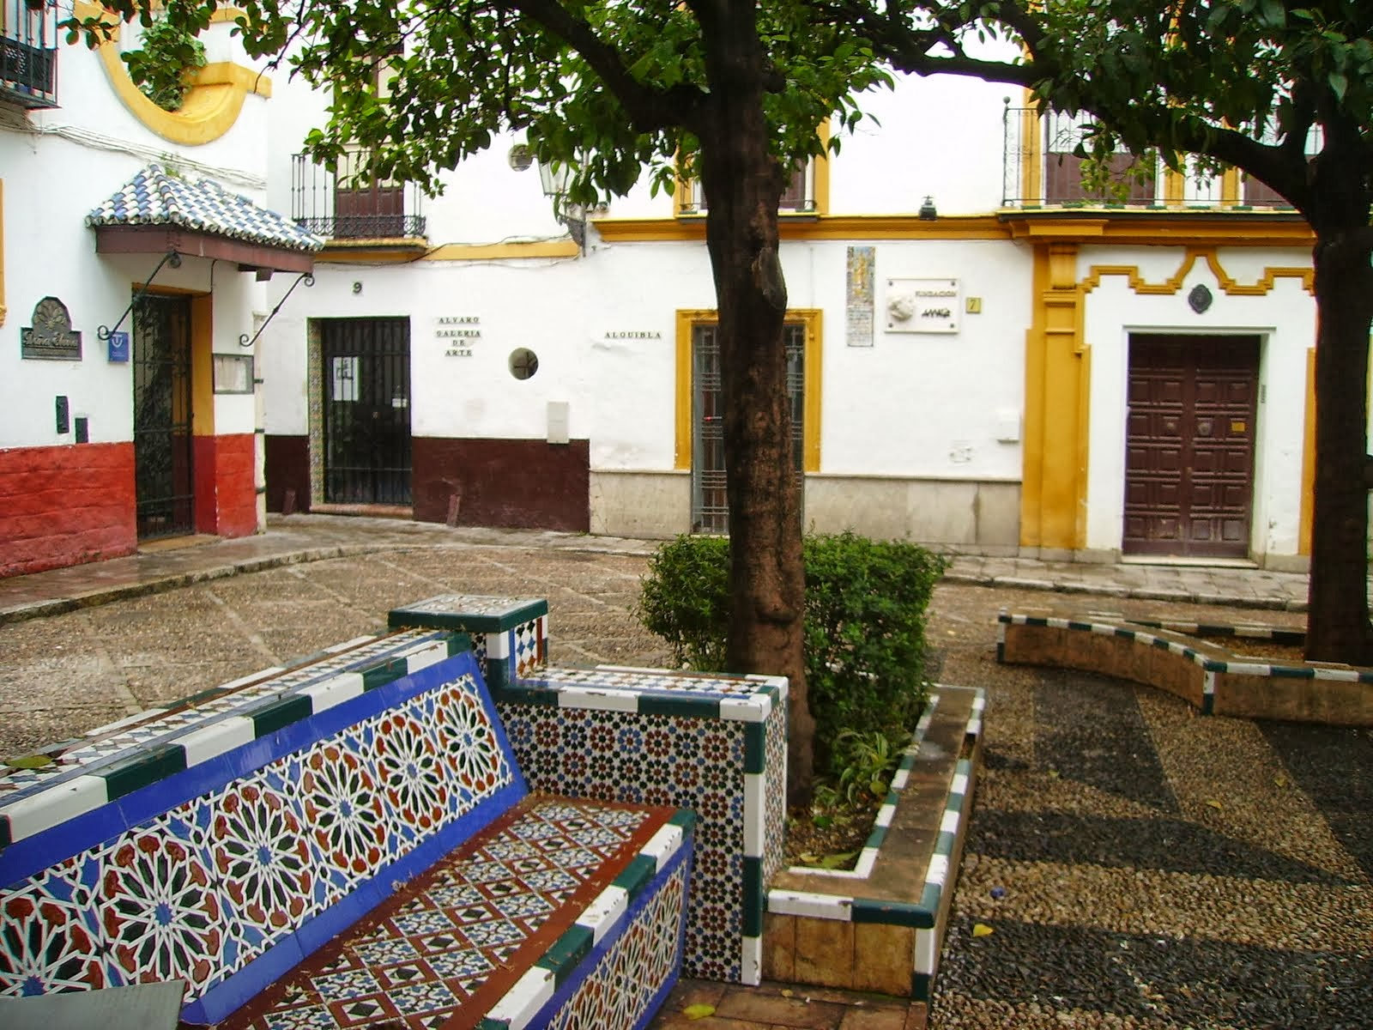
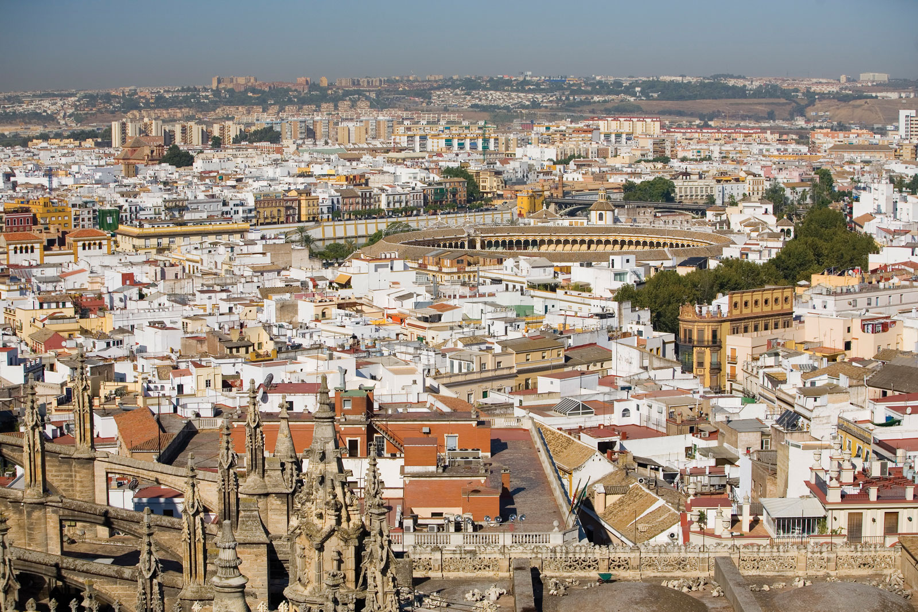
In 1649 there was hit of Plague and half of Sevilla‘s citizens were dead
Sevilla‘s economy was downgrade
Sevilla again got an influence in 20th century

Slide 5
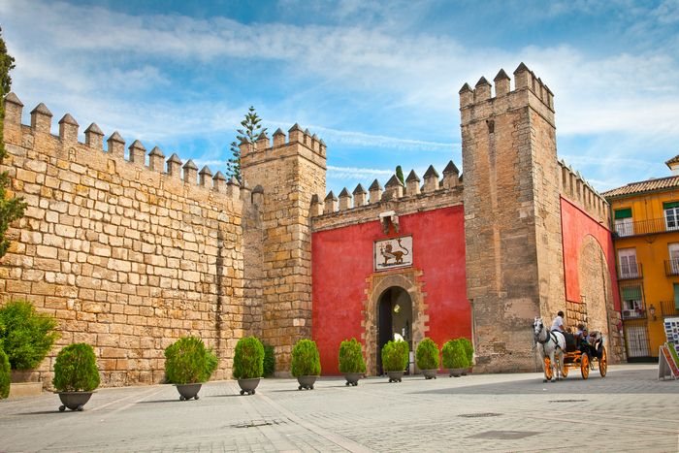
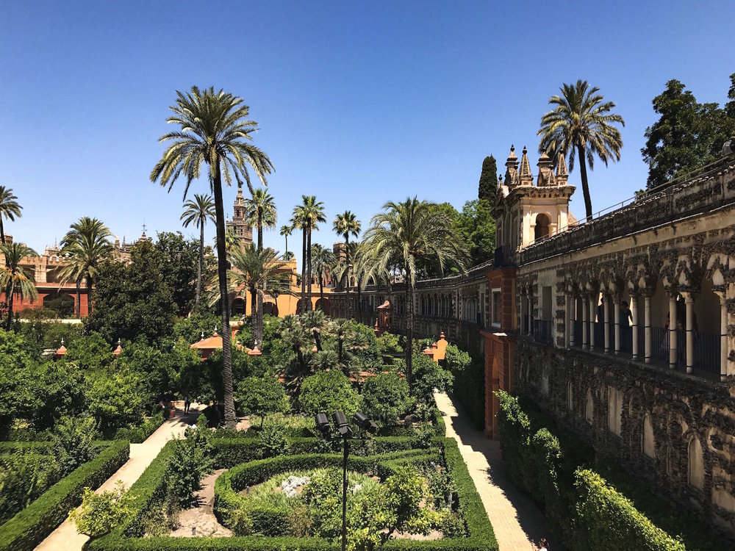
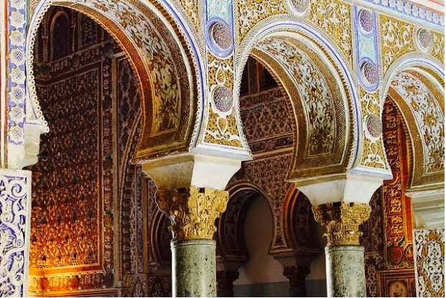
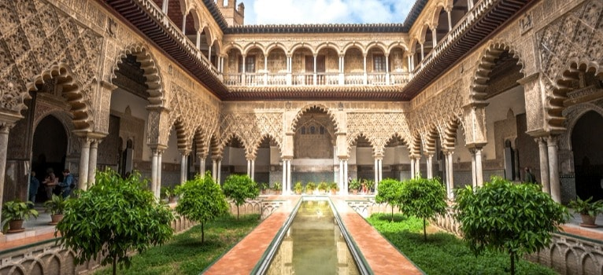
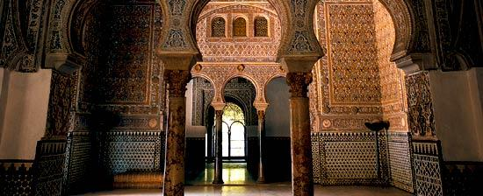
Alcázar
From arabic word al-qasr, meaning castle or fortress
It was built in the 14th and 15th centuries
Protected by UNESCO
https://www.youtube.com/watch?v=eUMsJ3d7RWE

Slide 6
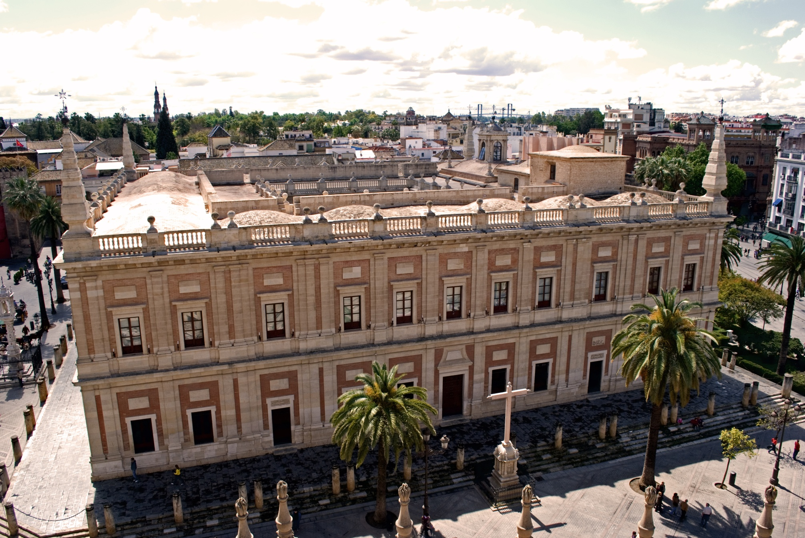
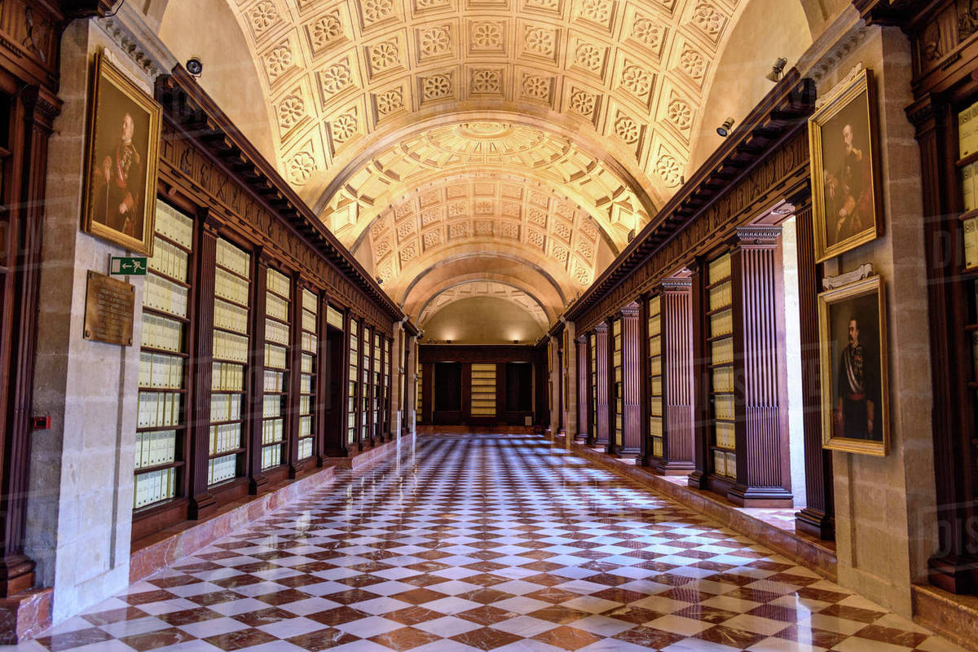
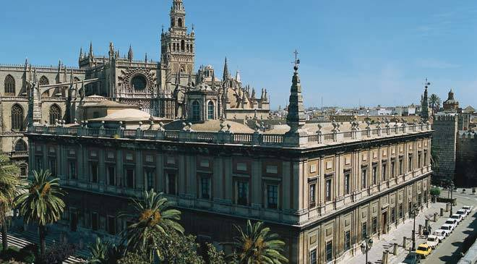
General Archive of the Indies
Archives contain contractes of sale and documents of discovery of New world
It was built in 16th century

Slide 7
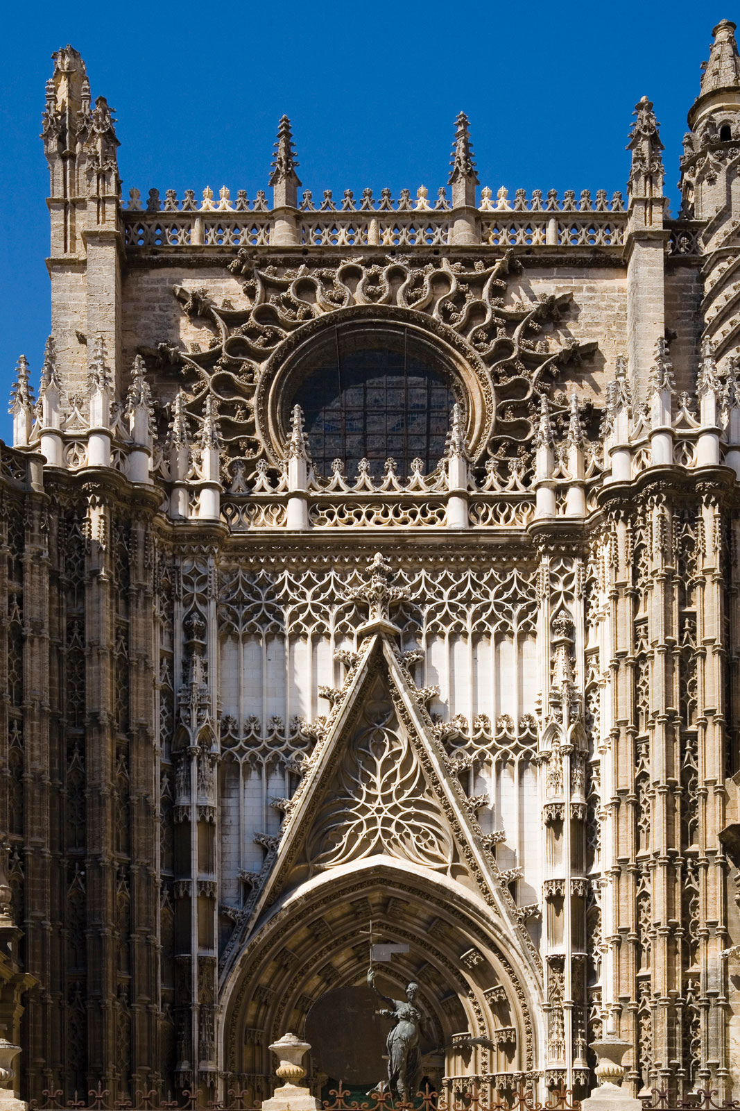
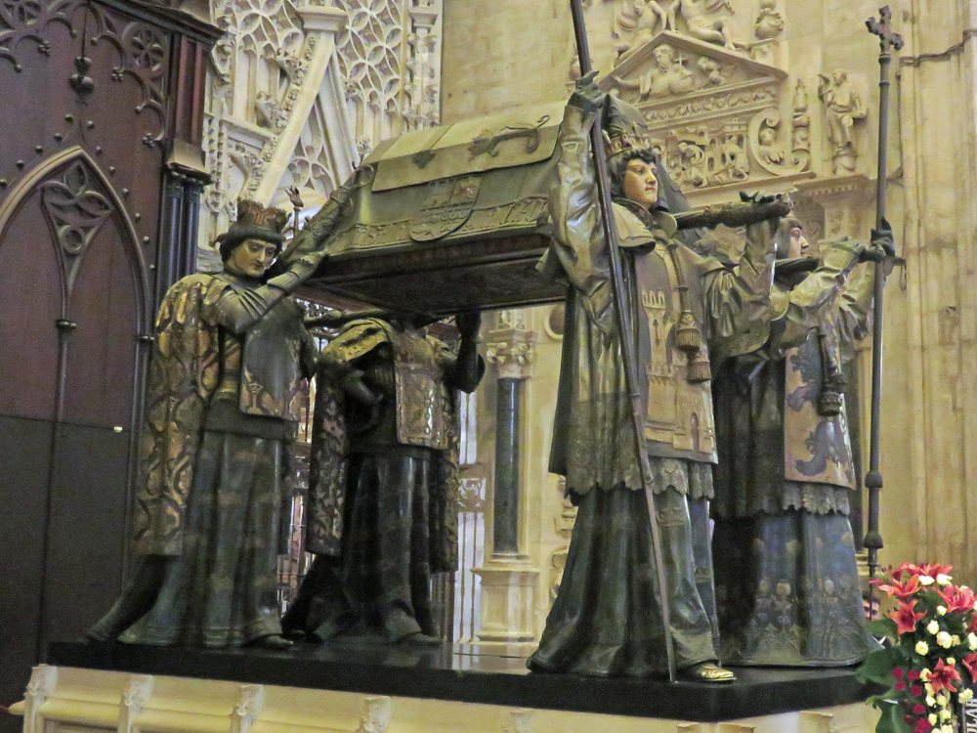
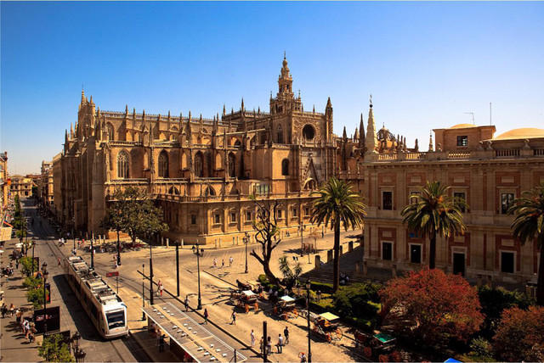
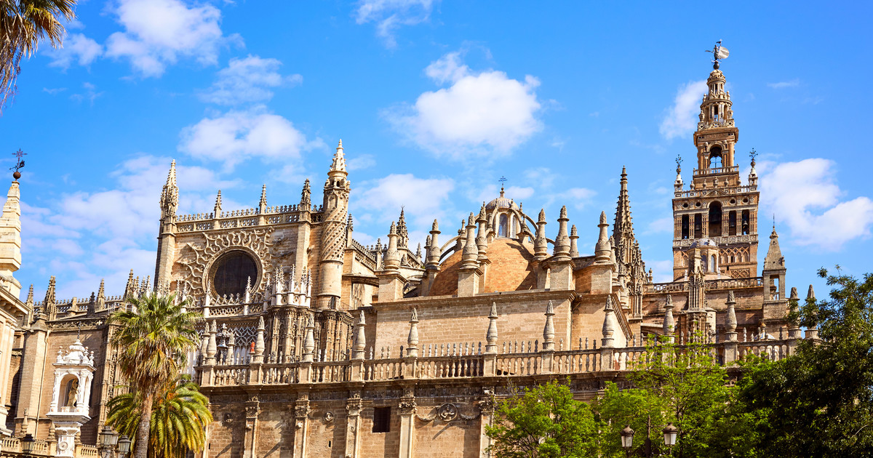
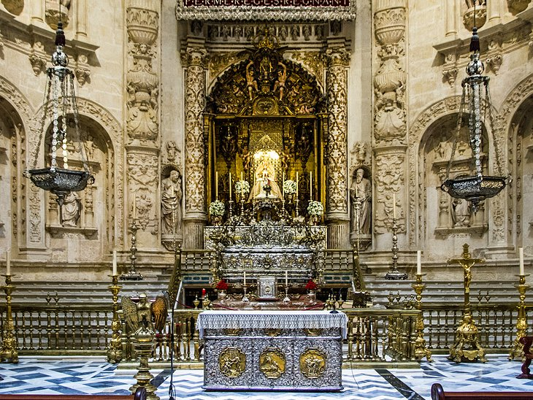
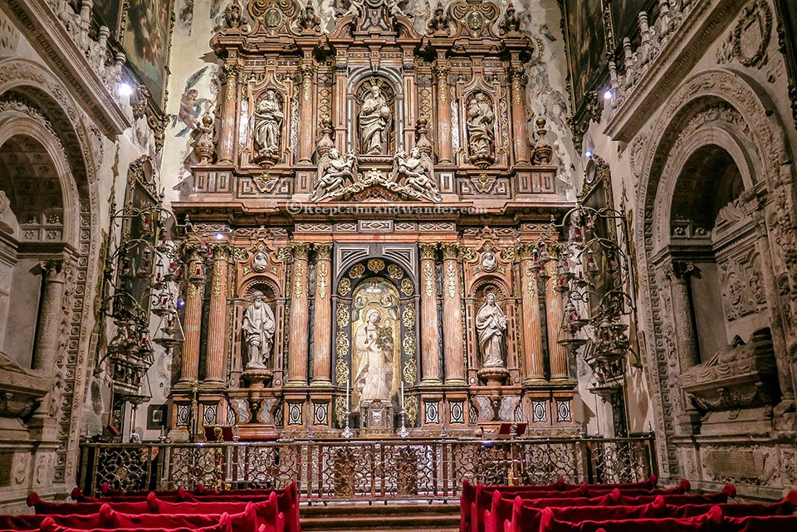
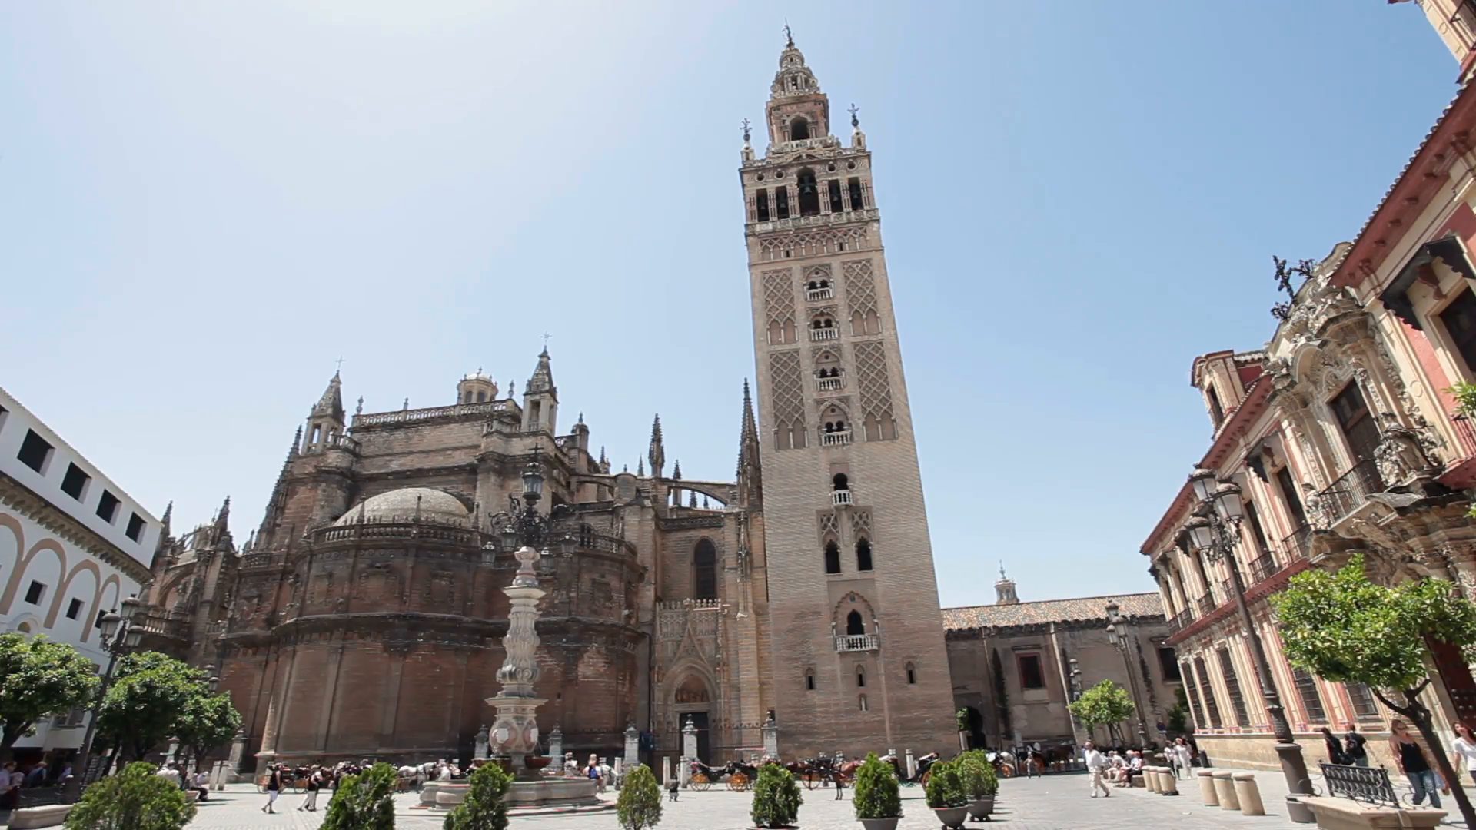
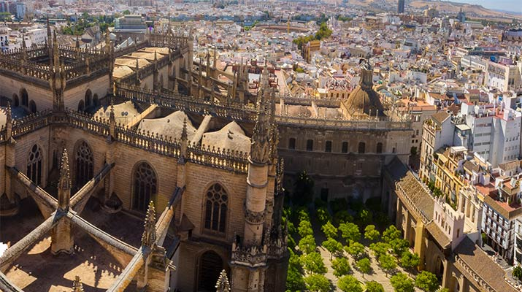
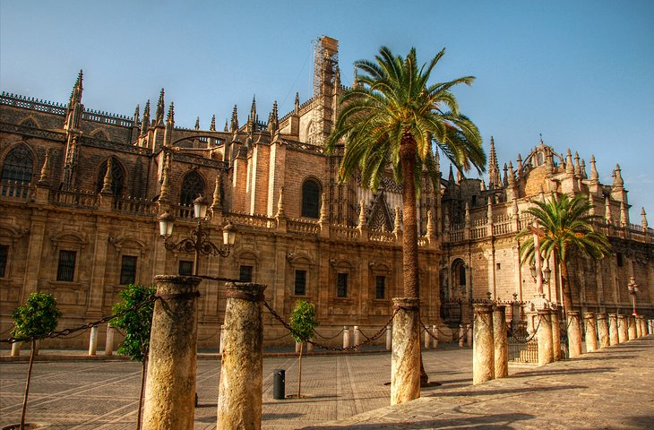
Seville Cathedral
All name is Cathedral of Saint Mary of the See
Completed in 1528
Height 42 metres
Width 100 metres
Length 135 metres
Protected by UNESCO
https://www.youtube.com/watch?v=gkFi-cIPpgY

Slide 8
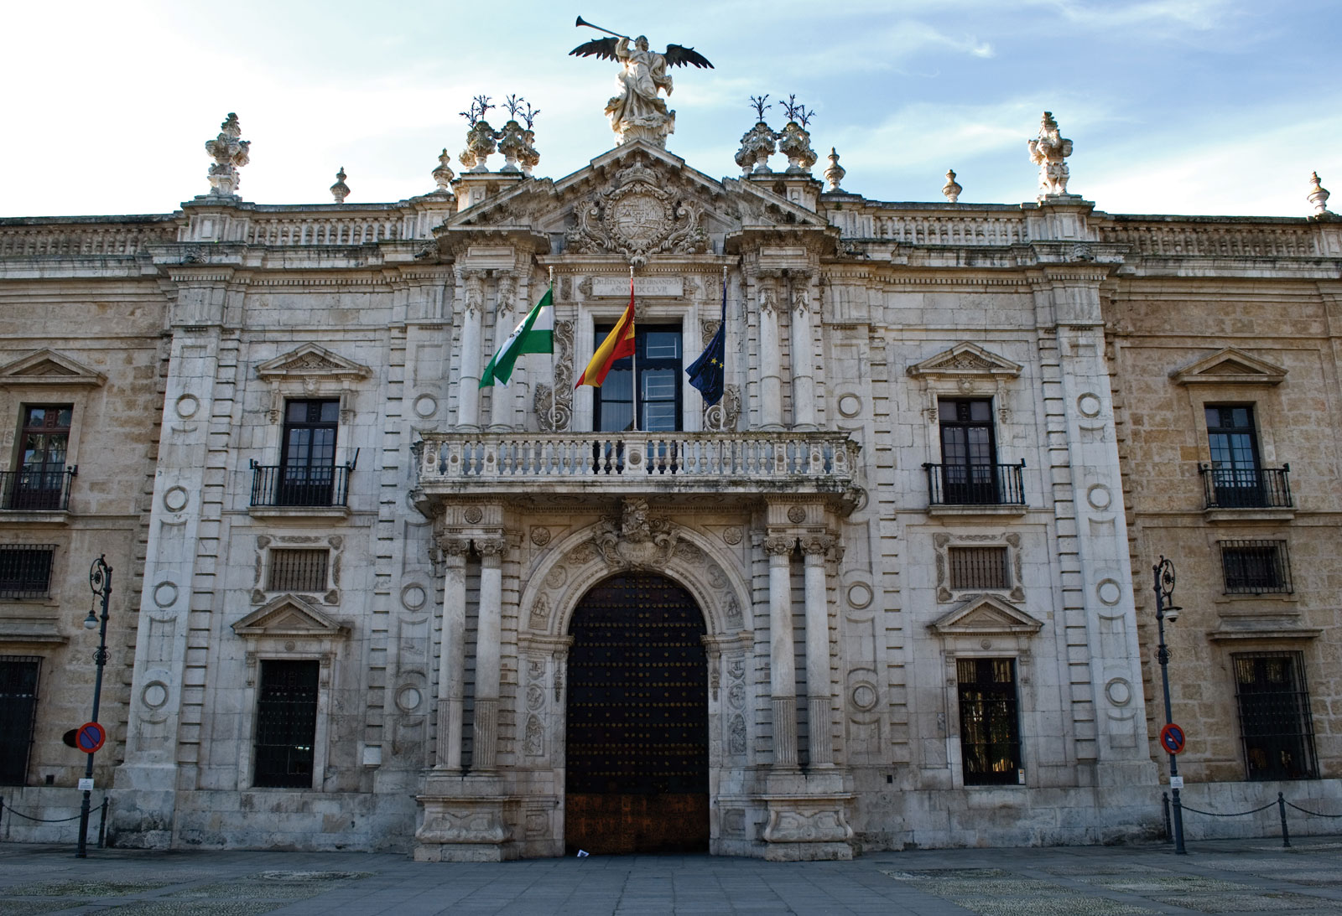
University of Sevilla
May have begun as early as 1254, but received university status in 1505
University is one of the oldest universities in Spain

Slide 9
Next videos
Torre del Oro- https://www.youtube.com/watch?v=CL9AMU_zzAc
Plaza de España- https://www.youtube.com/watch?v=yGxrj0aO78A
Barrio de Santa Cruz- https://www.youtube.com/watch?v=ri9cpeOTu2E

Slide 10
Source
https://www.britannica.com/place/Spain/History
https://www.britannica.com/place/Sevilla-Spain
https://www.britannica.com/technology/alcazar-Spanish-fortress
https://www.britannica.com/search?query=sevilla+indian+archives&engine=bss
https://www.britannica.com/topic/University-of-Sevilla
https://www.youtube.com/watch?v=nPcfZLaMoAo
https://otik.uk.zcu.cz/bitstream/11025/22741/1/Bakalarska%20prace_Matasova_IslamskaarchitekturavSeville.pdf
https://dspace.cuni.cz/handle/20.500.11956/37235

